Slide 1
ridge regression
Overview
Main ideas behind Ridge regression
How it works
Situations where Ridge regression works
Machine learning

Slide 2
Why ridge regression
Motivation: too many predictors
It is not unusual to see the number of input variables greatly exceed the number of observations, e.g. micro-array data analysis, environmental pollution studies.
With many predictors, fitting the full model without penalization will result in large prediction intervals, and LS regression estimator may not uniquely exist.
Motivation: ill-conditioned X
Because the LS estimates depend upon (X′X)⁻¹, we would have problems in computing β_{LS}
In those cases, small changes to the elements of X lead to large changes in (X′X)⁻¹.
The least square estimator β_{LS} may provide a good fit to the training data, but it will not fit sufficiently well to the test data.

Slide 3
background
In some cases when we want to shrink or constrain the parameters that we estimate in a model.
For example,
Case 1 – To have a model that is less prone to over-fitting
Case 2 - we have variables that are correlated and want to check the stability of our estimates in the presence of multicollinearity
Case 3 - we want to select a subset of variables from a large number.
mechanisms for avoiding overfit is called regularization
Ridge regression
Lasso regression
ElasticNet regression

Slide 4
ridge regression
Ridge Regression is a technique for analyzing data that suffer from multicollinearity.
When multicollinearity occurs, least squares estimates are unbiased, but their variances are large so they may be far from the true value.
By adding a degree of bias to the regression estimates, ridge regression reduces the standard errors.
Also know as Tikhonov regularization

Slide 5
regularization
Regularized machine learning model, is a model that its loss function contains another element that should be minimized as well.
Let’s see an example:
L = ∑( Ŷ_{i}– Y_{i})² + λ ∑ β²
This loss function includes 2 elements.
the sum of square distances between each prediction and its ground truth.
The second element is the regularization term,

Slide 6
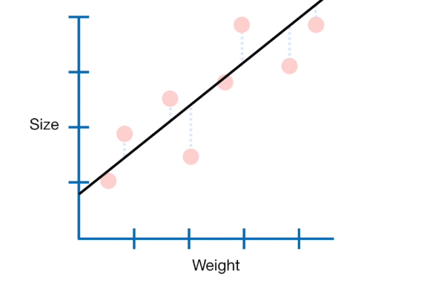
example
Data looks linear
We can use linear regression, (least squares to model the relationship between size and weight)
size = 0.9 + 0.75 * weight
We can be confident that the linear model will perform well if we have a lot of data points
size = 0.9 + 0.75 * weight

Slide 7
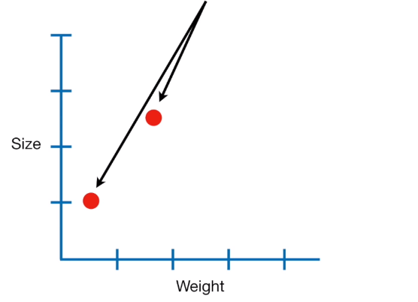
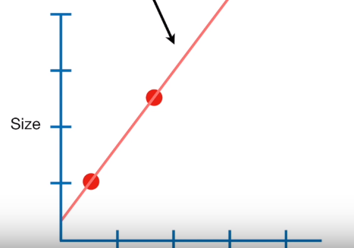
But …
What if we have only 2 measurements?
We fit a NEW LINE with least squares

Slide 8
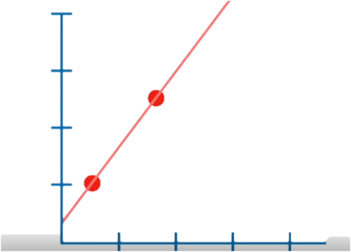
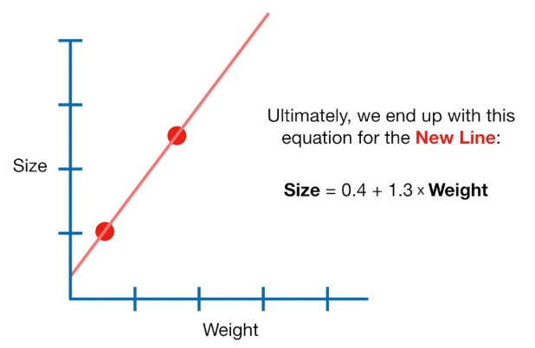
comparison
Since the NEW LINE overlaps the two data points, the minimum sum of squared residuals = 0

Slide 9
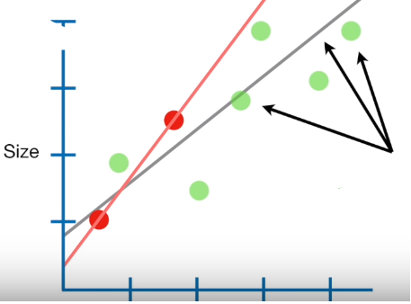
With original points
Let us call the 2 RED DOTS the training data and the remaining Green Dots the testing data
The sum of the squared residuals for the just 2 RED DOTS is small (in this case 0)
The sum of squared residuals for the GREEN DOTS, the testing data is large
That means the NEW LINE has High variance. We also say in ML language that the NEW LINE is Overfit to the training data.
Here are the original data and original line, with the NEW LINE

Slide 10
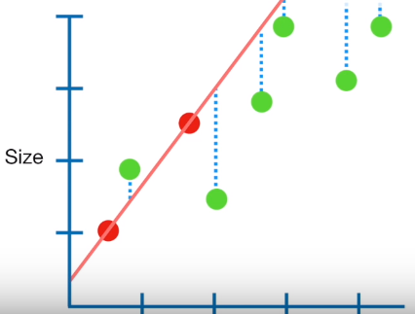
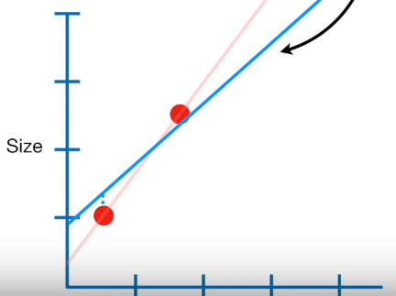
Main idea behind ridge regression
We just saw that the Least Squares results is a LINE that is overfit and has High variance
The main idea behind Ridge Regression is to find a New line that doesn't fit the Training Data as well.
How .. We introduce a small amount of Bias into how the New Line is fit to the training data

Slide 11
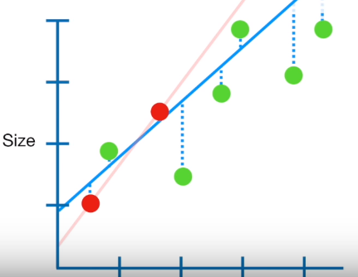
result
In return for that small amount of Bias, we get a significant drop in Variance.
In other words, by starting with slightly worse fit, Ridge regression can provide better long term predictions

Slide 12
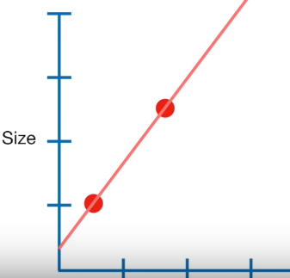
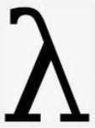
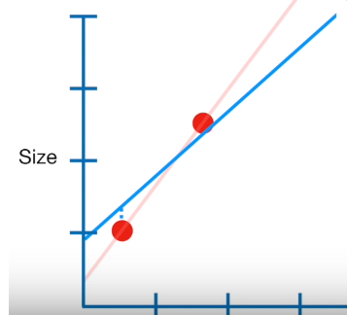
How ridge regression works
When Lease Squares determines values for the parameters in the linear equation …
size = y-intercept + slope * weight
.. It minimizes The sum of the squared residuals
In contrast when Ridge Regression determines values for the parameters in the linear equation …
size = y-intercept + slope * weight
.. It minimizes … The sum of the squared residuals
plus * slope²
penalty
Severity of penalty

Slide 13
Let us understand it better
Plug in the numbers that correspond to the Least Squares Fit
size = 0.4 + 1.3 * weight
(The sum of the squared residuals) + * slope²
Plug in the numbers for Ridge Regression line
size = 0.9 + 0.8 * weight
(The sum of the squared residuals) + * slope²
0.3²
0.1²
= 1
= 0.8²
= 1
= 1.3²
1.69
0.74

Slide 14
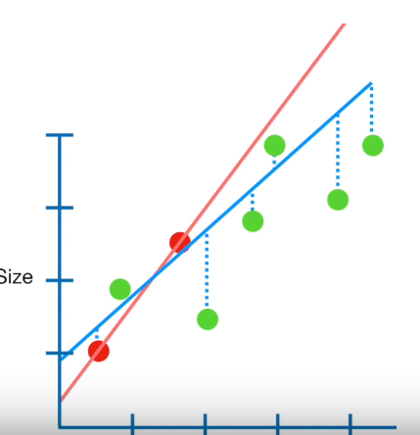
basically
With small amount of bias the Ridge Regression line has less variance

Slide 15
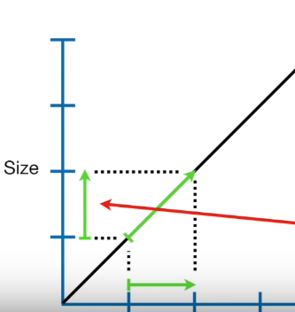
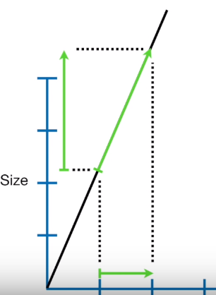
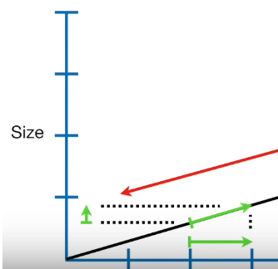
slope
When the slope is steeper, the prediction (y) is more sensitive to change in X
Y is less sensitive
1 unit increase in X leads to 1 unit increase in y

Slide 16
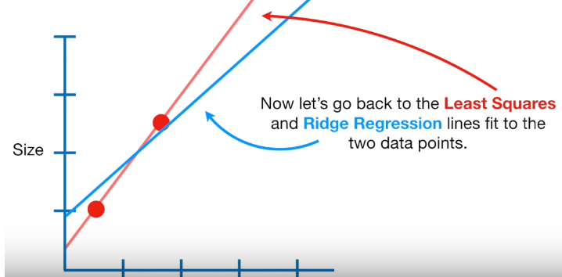
It means …
The Ridge regression penalty resulted in a line that has smaller slope.
That means predictions made by Ridge regression lines are less sensitive to X

Slide 17
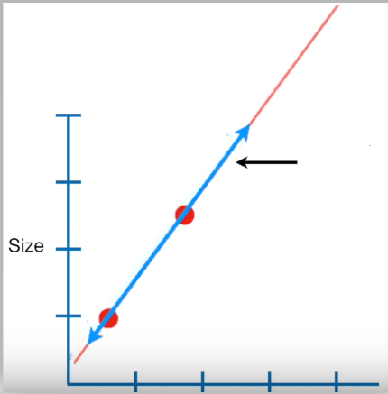
lambda
When lambda = 0, the Ridge regression line and Lease Square line is same.
Sum of the residuals + lambda * slope²
Sum of the residuals + 0
Lambda = 2 (slopes gets even smaller)
Lambda = 1 (slope gets smaller)

Slide 18

Lambda
λ controls the strength of the penalty term.
If λ = 0, the objective becomes similar to simple linear regression. So we get the same coefficients as simple linear regression.
If λ = ∞, the coefficients will be zero because of infinite weightage on the square of coefficients as anything less than zero makes the objective infinite.
If 0 < λ < ∞, the magnitude of λ decides the weightage given to the different parts of the objective.
In simple terms, the minimization objective = OLS Obj + λ (sum of the square of coefficients)

Slide 19
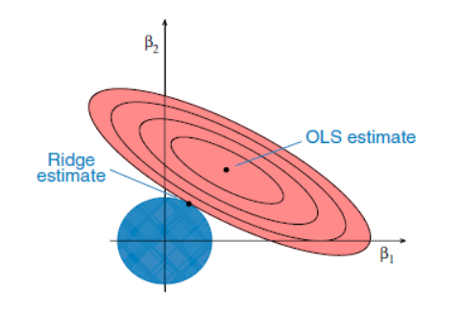
Geometric interpretation
The ellipses correspond to the contours of residual sum of squares (RSS): the inner ellipse has smaller RSS, and RSS is minimized at ordinal least square (OLS) estimates.
For p = 2, the constraint in ridge regression corresponds to a circle, ∑p_{j=1}β²_{j} < c.
Goal is to minimize the ellipse size and circle simultaneously in the ridge regression. The ridge estimate is given by the point at which the ellipse and the circle touch.

Slide 20
Geometric interpretation
There is a trade-off between the penalty term and RSS.
a large β would give a better residual sum of squares but then it will push the penalty term higher.
prefer smaller β's with worse residual sum of squares.
The larger the λ is, the more you prefer the β_{j}'s close to zero.
In the extreme case when λ=0, then you would simply be doing a normal linear regression.
And the other extreme as λ approaches infinity, you set all the β's to zero.

Slide 21
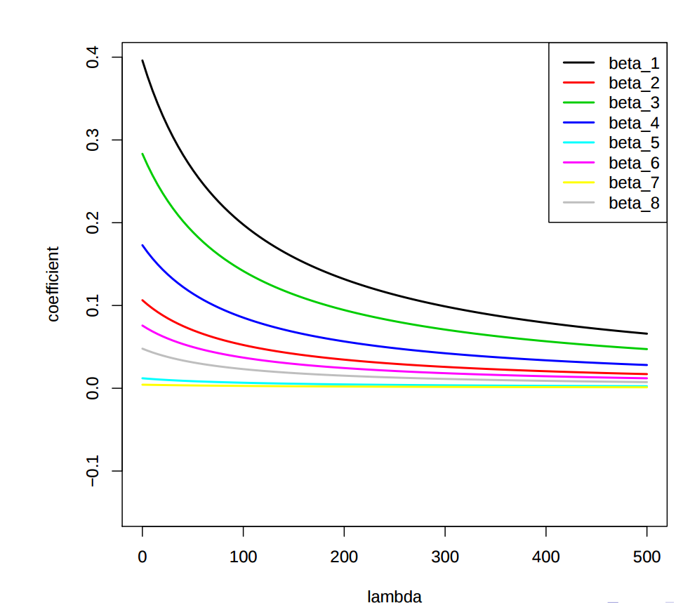
Ridge regression
The λ parameter is a scalar that should be learned as well, using a method called cross validation
enforces the β coefficients to be lower, but it does not enforce them to be zero.
That is, it will not get rid of irrelevant features but rather minimize their impact on the trained model.

Slide 22
Scitkit learn
class sklearn.linear_model.Ridge(alpha=1.0, fit_intercept=True, normalize=False, copy_X=True, max_iter=None, tol=0.001, solver=’auto’, random_state=None)[source]
alpha : {float, array-like}, shape (n_targets)
Regularization strength; must be a positive float.
Regularization improves the conditioning of the problem and reduces the variance of the estimates.
Larger values specify stronger regularization.
If an array is passed, penalties are assumed to be specific to the targets. Hence they must correspond in number.

Slide 23
Scitkit learn
class sklearn.linear_model.Ridge(alpha=1.0, fit_intercept=True, normalize=False, copy_X=True, max_iter=None, tol=0.001, solver=’auto’, random_state=None)[source]
normalize : boolean, optional, default False
If True, the regressors X will be normalized before regression by subtracting the mean and dividing by the l2-norm.
If you wish to standardize, please use sklearn.preprocessing.StandardScaler before calling fit on an estimator with normalize=False.

Slide 24
Scitkit learn
class sklearn.linear_model.Ridge(alpha=1.0, fit_intercept=True, normalize=False, copy_X=True, max_iter=None, tol=0.001, solver=’auto’, random_state=None)[source]
solver : {‘auto’, ‘svd’, ‘cholesky’, ‘lsqr’, ‘sparse_cg’, ‘sag’, ‘saga’}
Solver to use in the computational routines:
‘auto’ chooses the solver automatically based on the type of data.
‘svd’ uses a Singular Value Decomposition of X to compute the Ridge coefficients. More stable for singular matrices than ‘cholesky’.
‘cholesky’ uses the standard scipy.linalg.solve function to obtain a closed-form solution.
‘lsqr’ uses the dedicated regularized least-squares routine scipy.sparse.linalg.lsqr. It is the fastest and uses an iterative procedure.
‘sag’ uses a Stochastic Average Gradient descent, and ‘saga’ uses its improved, unbiased version named SAGA.

